Slide 1
ETL Pipeline For Global Cafe
Team Brewtopia
Imran (Scrum Master)

Slide 2

Content
Our Approach
The Problem
Business Aims
Product Architecture
AWS Services(Cloud)
Implementation
Visualisation
Challenges
Project Reflections

Slide 3
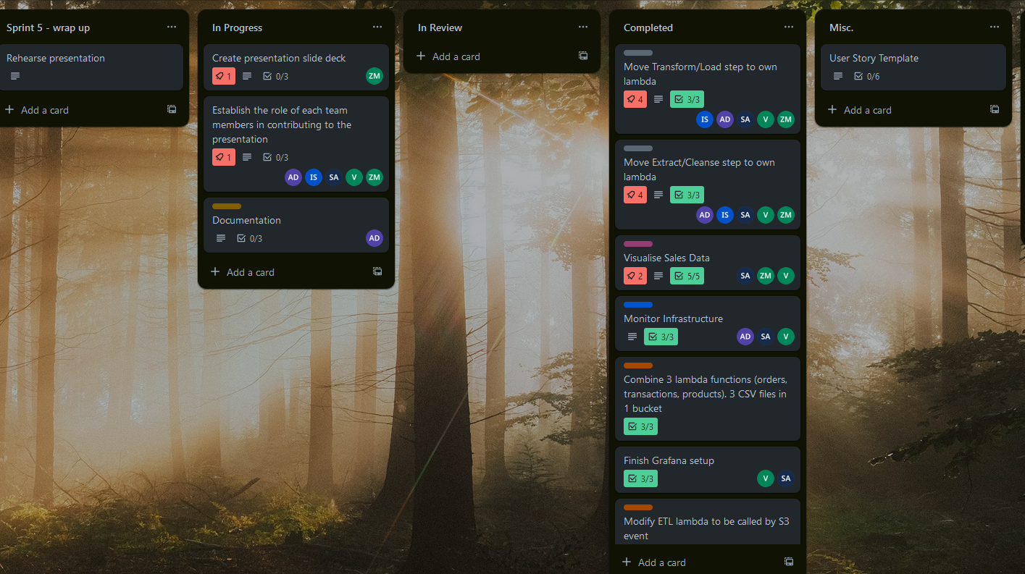
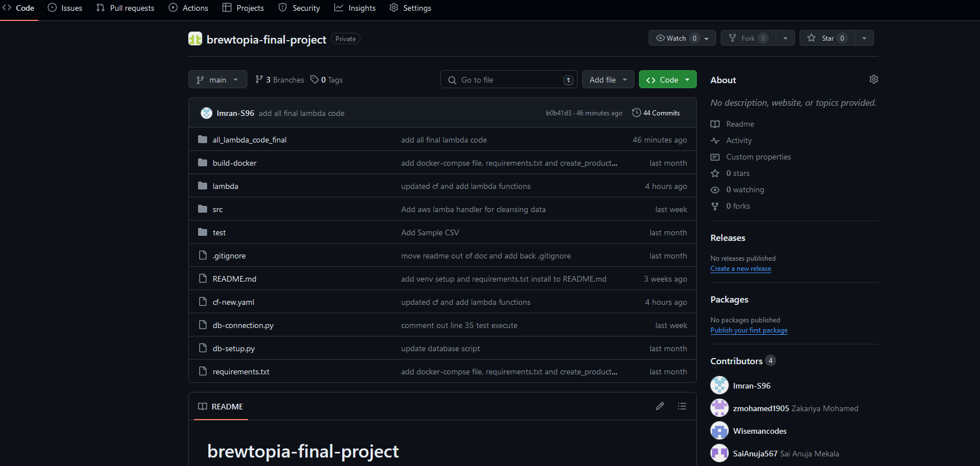
Our Approach
We worked in a group of five developers using SCRUM and Agile methodologies.
We broke tasks into weekly sprints and assigned tickets to different members of the team.
Maintained constant communication with daily standups and debriefs. Used Slack, Zoom, Trello and Github Repo.
Ensured we had regular check ins with the product owner to clarify any questions and to update him on our progress.
Trello
Github

Slide 4

The Problem
The software only persists data in a csv format for a single branch every day after the store closes.
The csv files often contain unorganised, sensitive and at times incorrect data.
Time consuming + costly
Unable to analyse the data to identify trends.
VS

Slide 5

Business Aims
Collect all the data from all branches at 8pm every night.
Cleanse and transform the data to be normalised.
Load the data into a Database.
Analyse the clean data to provide business insights and decision making.
Save time and money.
Drive business profit and growth margins.

Slide 6
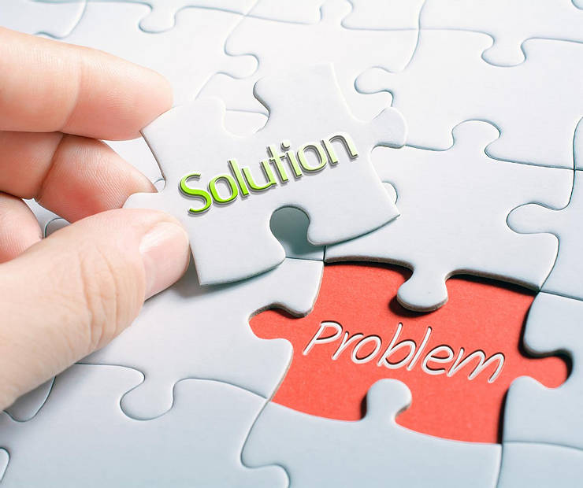
Our Solution
To create an ETL pipeline on the AWS cloud that extracts the transactional data from all branches, cleanses, normalises and transforms the data.
Analyse the data using a data visualisation tool.
Provide business insights to help drive decision making and increase profit margins.

Slide 7
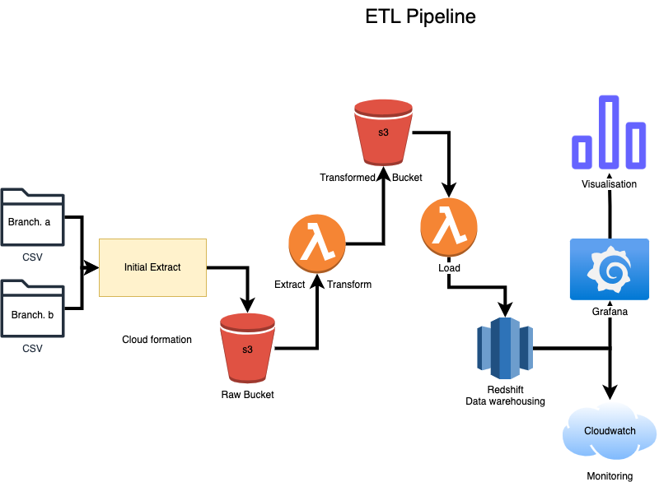
Product Architecture

Slide 8




AWS Services (Cloud)
Cost-effectiveness
Pay-as-you-go model
No Hardware Maintenance Cost
Accessibility
Global infrastructure
Ease of deployment
Scalability
Elasticity
Auto-scaling
Security
Built-in security features
Speed
Real-time Data
Fast provisioning
S3 BUCKET
REDSHIFT
LAMBDA
EC2

Slide 9
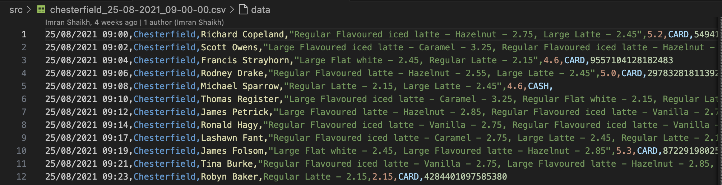
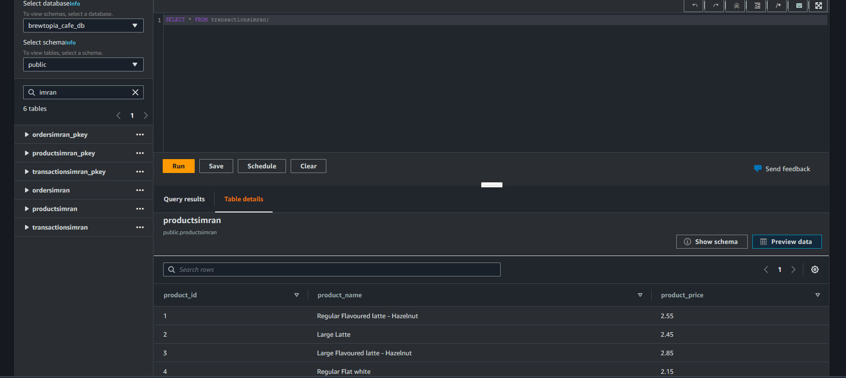

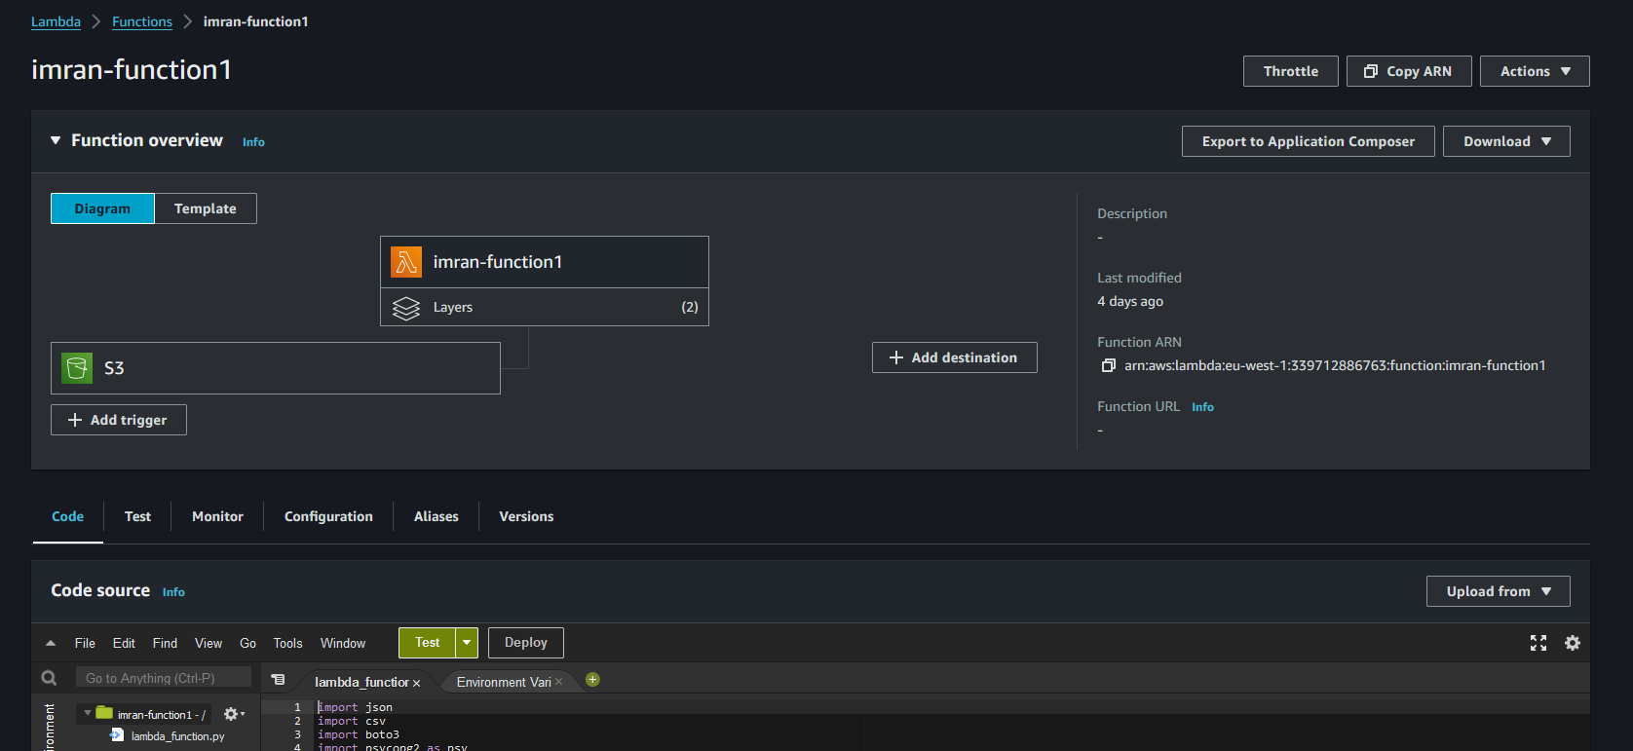
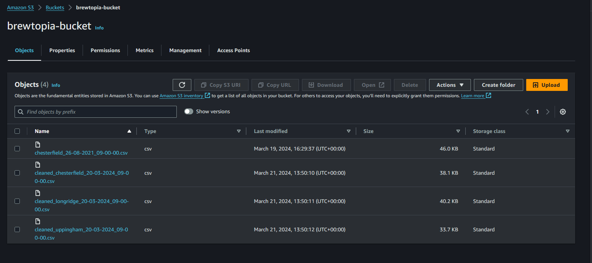
Product Implementation
Lambda
S3
Redshift
CSV FILE
REDSHIFT DATABASE
S3 BUCKET
LAMBDA FUNCTION

Slide 10
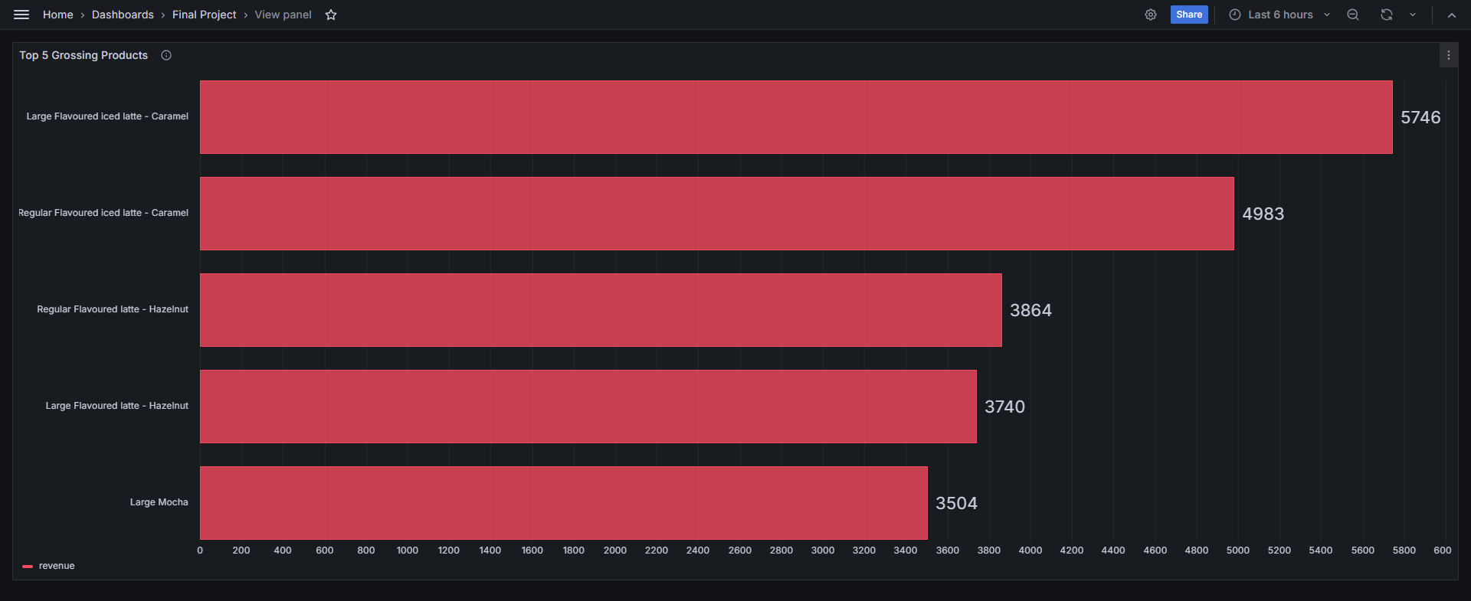
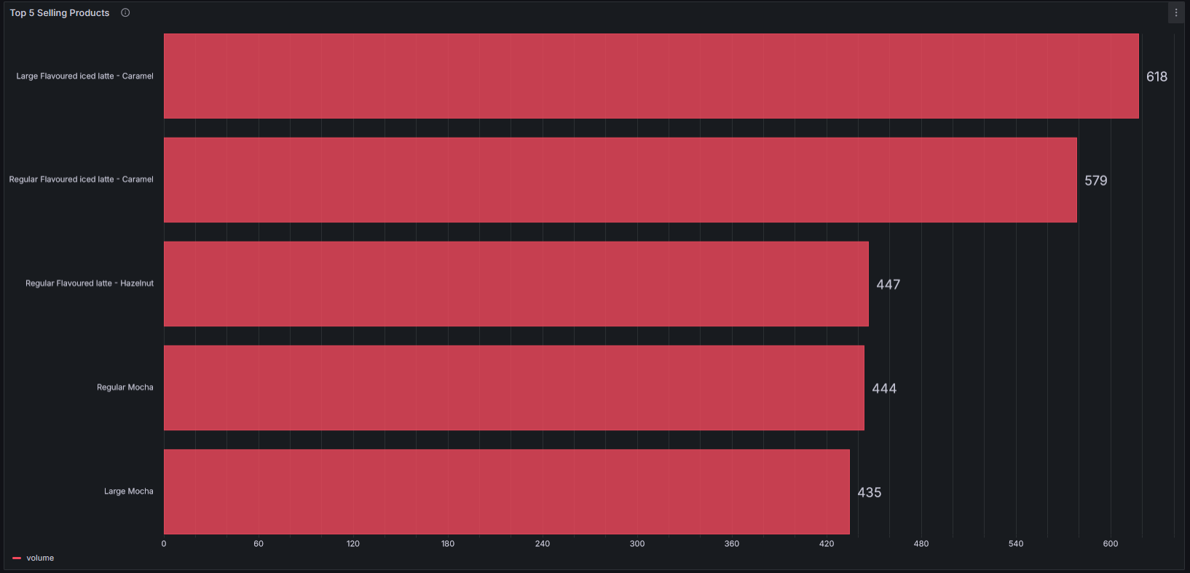
Top 5 Grossing Products
Correlation
Most products correlate between the 2 tables.
However Regular Mocha is the 4th highest selling product but isn't on the top 5 grossing products table and instead Large Flavoured latte - hazelnut is in its place and vise versa.
Top 5 Selling Products
Recommendation
Increase the marketing for Large Flavoured latte - hazelnut to sell more product.
Increasing the price of the Regular Mocha.
Implementing both changes would maximise revenue for the business.

Slide 11
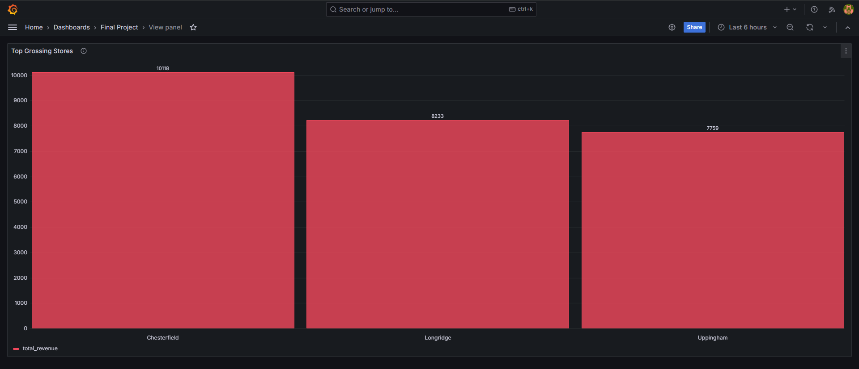
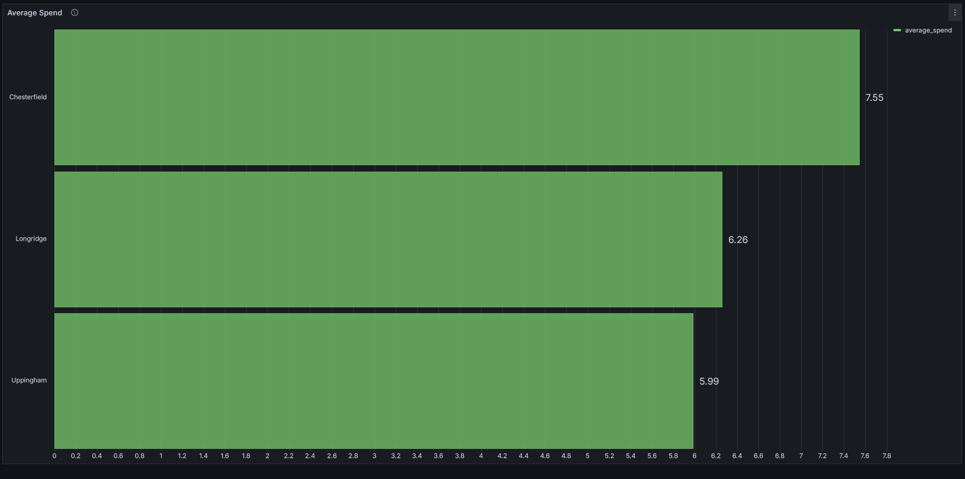
Top Grossing Stores
Correlation
Both tables show a 1-to-1 correlation between the Top Grossing Stores and the Average Spend per customer.
Average Spend
Recommendation
Chesterfield should be promoted and marketed as the flagship store.

Slide 12
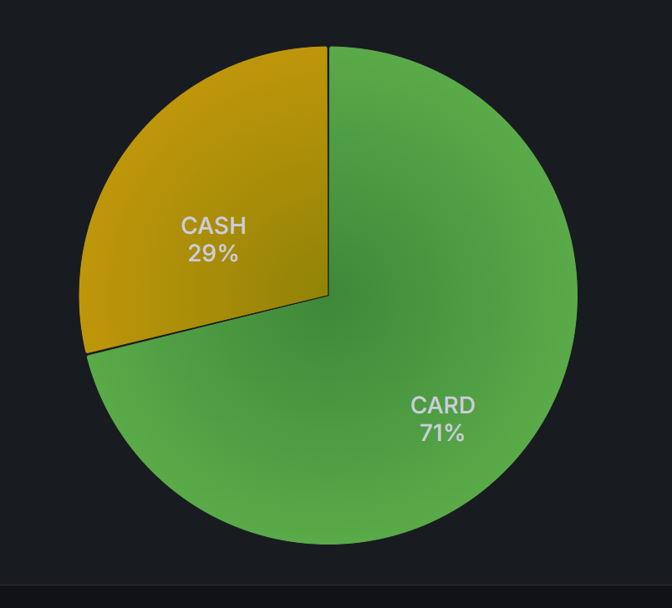
Payment Method
Trends
Similar businesses going cashless to reflect modern times.
Recommendation
Not to follow the trend as cash payments make almost a third of total revenue.
Alternatively, marketing the cafe stores as a blend between traditional and modern, will make them stand out from the competition.
Potentially install self service machine to deal with increased traffic in the top grossing store(Chesterfield)

Slide 13
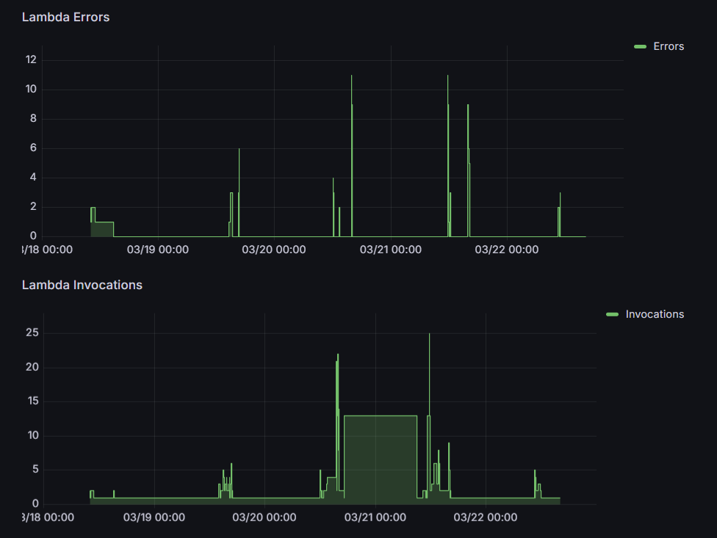
Monitoring
Observe, Collect and Analyze Metrics
Performance, health, and behavior
Identify patterns, trends, anomalies, and potential issues.

Slide 14

Challenges we faced
AWS
Lambda
Integrating existing code
Layers - Psycopg2
Loading into Redshift

Slide 15

Project Reflections
Meeting the requirements - We were able to create the ETL pipeline to a high standard which allowed us to take messy data and convert this to useful business insights in Grafana.
Agile and SCRUM -frameworks allowed us to break tasks down into more manageable chunks. This could also be adapted if needed.
Future additions - we can look at adding SQS for added security, durability and availability.
Finally, the introduction of a self service machine could further increase profit margins.

Slide 16


